Slide 1

FreeBSD on ARM64 Hyper-V
- Wei Hu (whu@microsoft.com)
-Souradeep Chakrabarti(schakrabarti@microsoft.com)

Slide 2
Preface
Microsoft is currently offering Linux in ARM64 SKUs of Azure.
FreeBSD is available for x86 SKUs in Azure.
We are working on enabling FreeBSD on ARM64 SKUs of Azure.
The following slides are on the major changes done to make it happen.

Slide 3
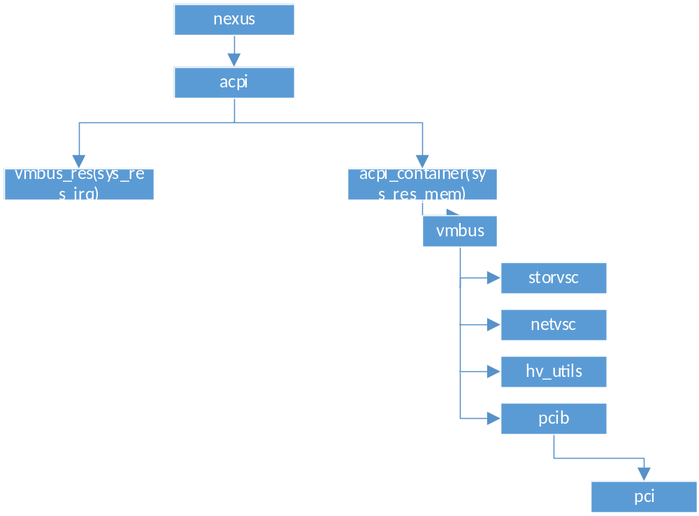
FreeBSD on ARM64

Slide 4
Existing Hyper-V device driver layout
vmbus/. The parent of all Hyper-V devices. It also contains code for early initialization, i.e. before any drivers are loaded.
vmbus/amd64/ and vmbus/i386/. Contains vmbus IDT vector entry and hypercall.
storvsc/. Synthetic SCSI controller driver.
netvsc/. Synthetic network controller driver.
pcib/. PCI bridge driver for SR-IOV/pass-through.
input/. Synthetic keyboard driver.
utilities/. Drivers for KVP, VSS, time synchronization etc.
include/. Shared header files; exposed by the vmbus.

Slide 5
New hyper-v device driver layout
- vmbus/aarch64/. Contains vmbus_aarch64.c, hyperv_reg.h, hyperv_machdep.h,
hyperv_machdep.c, hyperv_aarch64.c.
These files are specific for ARM64 Hyper-V.
vmbus_aarch64.c : Contains new interrupt handler setup and teardown code.
hyperv_aarch64.c : Contains Hyper-V identify.
hyperv_machdep.c : Contains new hypercalls for ARM64 Hyper-V.
hyperv_reg.h : Contains ARM64 specific synthetic MSR values.

Slide 6
Contd.
- vmbus/x86/. Contains vmbus_x86.c, hyperv_x86.c,hyperv_reg.h, hyperv_machdep.h .
These are for both i386 and amd64.
Also new file introduced hyperv_common_reg.h, which contains common
synthetic MSR values for Hyper-V.
This approach to avoid redundancy of the code.

Slide 7
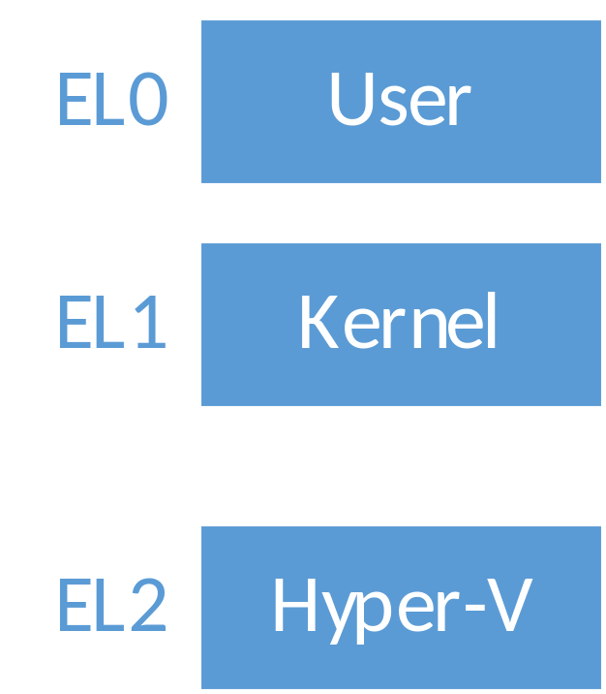
ARM SMCCC HVC
To implement writing of MSR and reading of MSR in ARM64 HvCallSetVpRegisters hypercall and HvCallGetVpRegisters hypercall is used.
To have the Hypercalls from El1 to El2, ARM SMCCC
HVC is used.
HvCallGetVpRegisters accesses registers beyond
a0 to a3. For that SMCCC 1.2 is implemented.
Code :
  https://github.com/freebsd/freebsd-src/blob/main/sys/dev/psci/smccc_arm64.S
  https://github.com/freebsd/freebsd-
  src/blob/main/sys/dev/psci/smccc.h

Slide 8
Hyper-v identify and LOAD
Azure ARM64 hosts virtualizes the system counter and timer defined by the ARM64 architecture.
Hyper-V synthetic timer counter initialization is not required here.
hypercall page setup is moved from hyperv.c to x86 specific hyperv_x86.c, along
with hyperv timer counter initialization.
hyperv_et.c is also not required for ARM64, it is only built now for x86.
Have used ACPI FADT to identify Hyper-V, which was done using CPUID in
x86.
Have used ARM SMCCC HVC to identify certain features of Hyper-V and
to set the guest OS id.

Slide 9
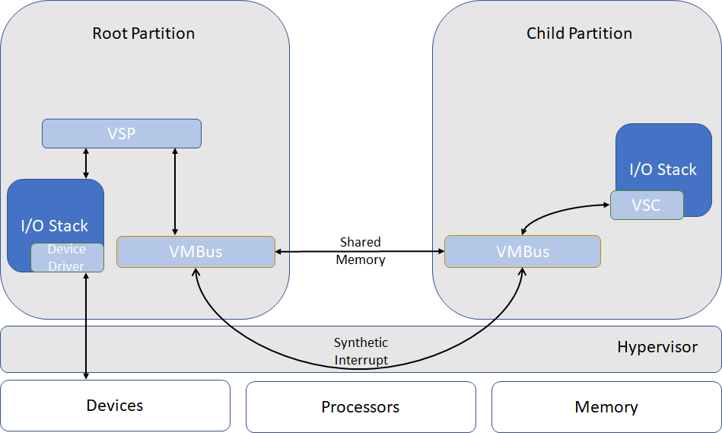
Hyper-V Vmbus

Slide 10
VMBUS Interrupt handling
In x86 VMBus was using Free IDT vector for Hyper-V ISR.
In ARM64 VMBus uses Interrupt mentioned in the _CRS of the HID VMBus.
This resource is currently owned
by vmbus_res as a direct child
of ACPI.
To access this resource from vmbus_res,
we have used :
devclass_get_device(devclass_find("vmbus_res"),0)
Also introduced new attributes in vmbus_softc:
ires, icookie and vector.
Name (_HID, "VMBus") // _HID: Hardware ID
Name (_UID, Zero) // _UID: Unique ID
...
Name (_CRS, ResourceTemplate () // _CRS: Current Resource Settings
{
Interrupt (ResourceConsumer, Edge, ActiveHigh, Exclusive, ,, )
{
0x00000012,
}

Slide 11
Contd.
From the successful allocated ires resource, we are getting the
irq number using rman_get_virtual(), which we are using then for synthetic
interrupt controller setup.
sc->vmbus_idtvec = irq_data->irq;
These changes are in vmbus_aarch64.c and the lapic based
IDT vector setup has been moved in vmbus_x86.c

Slide 12
Current work
Enabling vmbus_pcib for to use accelerated networking feature of Hyper-V in Azure.
Hyper-V does not emulate a full-fledged PCI bridge.
A cooperative PCI bridge driver is needed on FreeBSD.
  Handle PCI configuration space accessing.
  Setup BARs for SR-IOV/passed-through devices.
  Remap MSI/MSI-X data and address.
Following this work, we will have SR-IOV, NVME enabled for FreeBSD on ARM64 Hyper-V.

Slide 13
Thank You and Q&A

